Slide 1

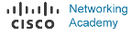
INFT 1012 Network Fundamentals
Week 10 – Topic Outline and Highlights

Slide 2
Topics
Binary and IPv4 addresses
IPv4 Addressing
IPv4 address structure & subnet mask
Network, host and broadcast addresses
IPv4 unicast, multicast and broadcast
Private and public addresses
IP address assignment

Slide 3
Readings
CCNAv7: Introduction to Networks course text & quizzes
Module 5 – Section 5.1
Module 11- Section 11.1, 11.2, 11.3
Available at: www.netacad.com

Slide 4
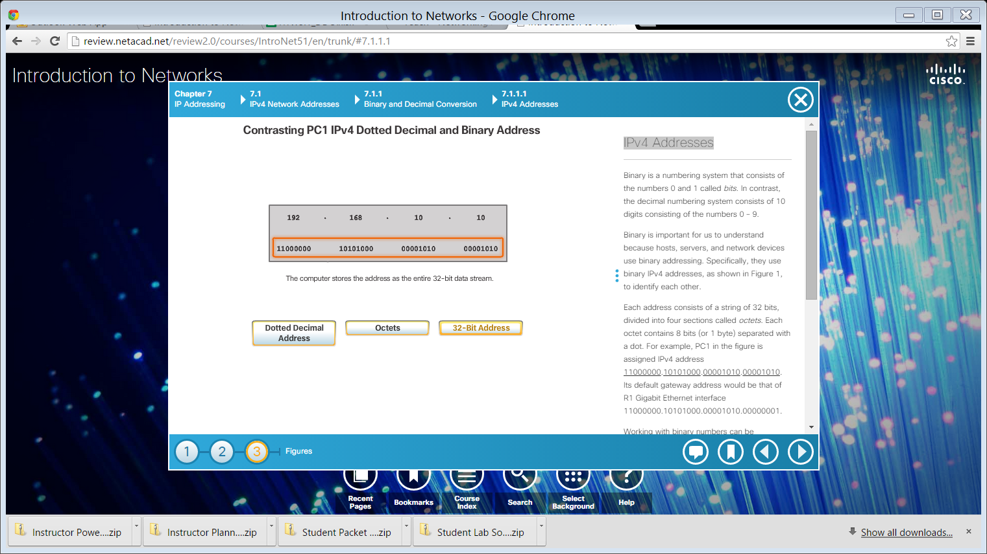

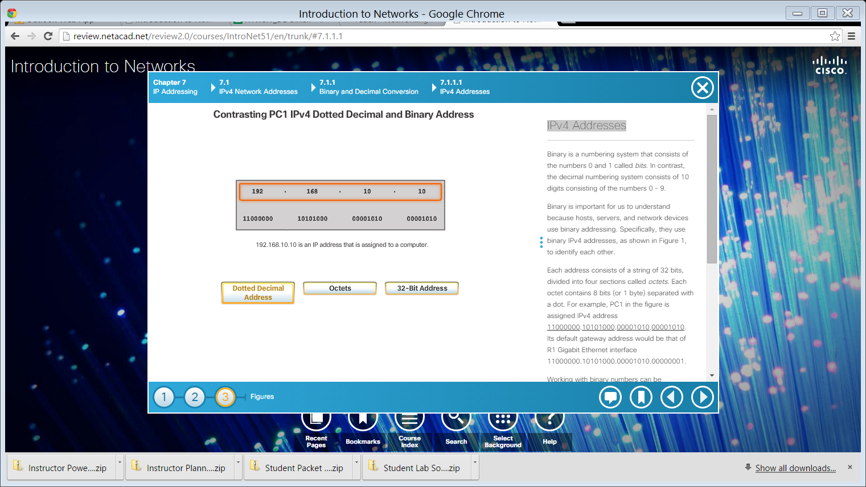
IPv4 Addresses
Each IPv4 address consists of 32 binary bits
These 32 bits are divided into 4 octets or bytes
1 octet = 1 byte = 8 bits
Dotted Decimal Format
For ease of use by people, IPv4 addresses are commonly expressed in dotted decimal notation

Slide 5
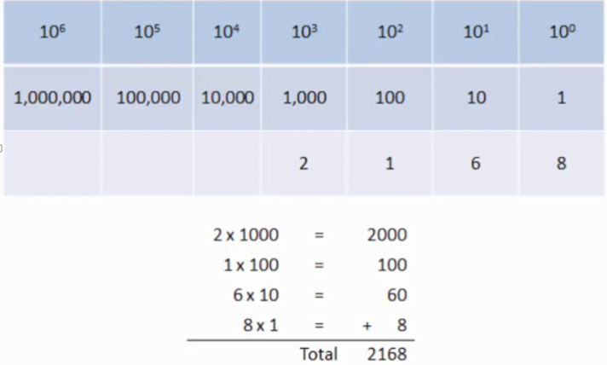
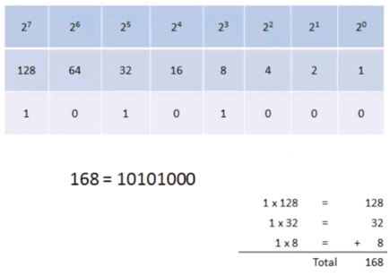
Decimal system vs Binary system
Both decimal and binary systems are positional notation systems, meaning that a digit represents different values (place values), depending on the “position” or place of the digit occupies in the sequence of numbers
The decimal system is a base 10 positional notation system, with 10 digits (0, 1, …, 9)
The place values for the decimal system are based on powers of 10
The binary system is a base 2 positional notation system, with 2 digits (0, 1)
The place values for the binary system are based on powers of 2

Slide 6
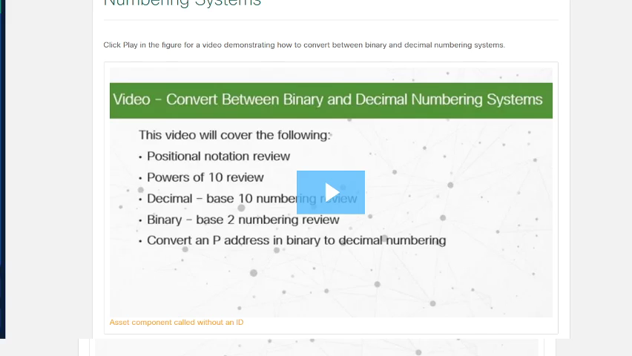
Binary and Decimal Conversion
We can convert between binary and decimal numbers.
Watch the video to learn how to do the conversions. Pay attention to how to convert an IPv4 address from its dotted decimal format to its binary format and vice versa.
Notes:
Binary and Decimal Conversion Examples:
32-Bit Binary Address = 11000000 10101000 01100100 00001011
Dotted Decimal Address = ?
Octet 11000000 = 1x128 + 1x64 + 0x32 + 0x16 + 0x8 + 0x4 + 0x2 + 0x1 = 192
Octet 10101000 = 1x128 + 0x64 + 1x32 + 0x16 + 1x8 + 0x4 + 0x2 + 0x1 = 168
Octet 01100100 = 0x128 + 1x64 + 1x32 + 0x16 + 0x8 + 1x4 + 0x2 + 0x1 = 100
Octet 00001011 = 0x128 + 0x64 + 0x32 + 0x16 + 1x8 + 0x4 + 1x2 + 1x1 = 11
Therefore, Dotted Decimal Address = 192.168.100.11
Dotted Decimal Address = 172.16.30.99
32-bit Binary Address = ?
172 = 1x128 + 0x64 + 1x32 + 0x16 + 1x8 + 1x4 + 0x2 + 0x1 → 1st Octet = 10101100
16 = 0x128 + 0x64 + 0x32 + 1x16 + 0x8 + 0x4 + 0x2 + 0x1 → 2nd Octet = 00010000
30 = 0x128 + 0x64 + 0x32 + 1x16 + 1x8 + 1x4 + 1x2 + 0x1 → 3rd Octet = 00011110
99 = 0x128 + 1x64 + 1x32 + 0x16 + 0x8 + 0x4 + 1x2 + 1x1 → 4th Octet = 01100011
Therefore, 32-bit Binary Address = 10101100 00010000 00011110 01100011

Slide 7
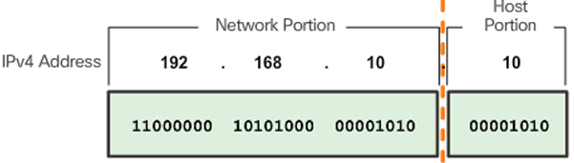
IPv4 Address Structure
The 32 bits of an IPv4 address are divided into 2 portions:
Network portion – higher/left bits in the address
For all interfaces in the same network/subnet, the network portion of their IP addresses must be the same. Also known as network ID
Host portion – lower/right bits in an address
The bits of the host portion must be unique for each address belonging to the same network/subnet. Also known as host ID.
Note that #network bits + #host bits = 32
Example:
For the above example IP address, its network portion/ID comprises 24 bits and host portion/ID comprises 8 bits
However, note that in general the number of bits contained in the network or host portion of an IP address may not be a multiple of 8 bits, i.e. not in whole octets. (example on later slide)

Slide 8
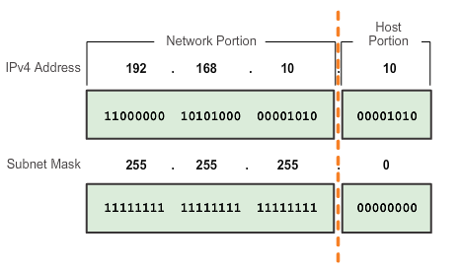
Subnet Mask
A subnet mask is a 32-bit number or pattern specifying which part of an IP address is the network/subnet portion and which part is the host portion
1s are on the left, indicating that the corresponding bits in the associated IP address are network bits
0s are on the right, indicating that the corresponding bits in the associated IP address are host bits
A subnet mask does not actually contain the network or host portion of an IPv4 address. It just says where to look for these portions in an address
An IP address and its subnet mask often are written as: a.b.c.d/x, e.g. 192.168.10.10/24, known as “slash notation” or CIDR notation, where x is called prefix length and it is the number of bits in the subnet portion of an address, or equivalently the number of 1s in the subnet mask.

Slide 9
Subnet Mask
Play slideshow to see animations
Note that the network portion and host portion of an IP address do not always contain whole octets, so it is necessary to convert an IP address and its subnet mask from dotted-decimal format to binary format to look for the address’ network portion and host portion
Example:
IP address: 192.168.10.10; Subnet mask: 255.255.192.0
Only after having converted the address and subnet mask to binary format as follows, we know that the network portion contains 18 bits and the remaining 14 bits are for the host portion of this address.
network portion
192.168.10.10 → 11000000 10101000 00001010 00001010
255.255.192.0 → 11111111 11111111 11000000 00000000
host portion

Slide 10
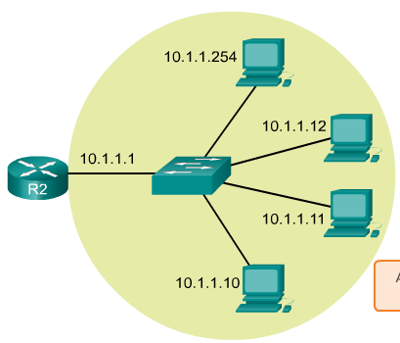
Terminology–Network, Subnet, IP address range
Play slideshow to see animations
When we talk about an IP “network” or “subnet” at the network layer: network = subnet = “(correctly specified) range of IP addresses”
For example, the network shown on the left can be referred by the subnet or the range of addresses shown on the right, 10.1.1.0 to 10.1.1.255
10. 1. 1. 0
Same network bits/ID for all addresses in the same network
10. 1. 1. 1
…
10. 1. 1. 10
…….
10. 1. 1. 157
…….
10 . 1 . 1. 254
10 . 1 . 1. 255

Slide 11
Network, Host and Broadcast Addresses
Play slideshow to see animations
Within a network or the range of IP addresses, we distinguish between 3 types of addresses:
Network address:
The very 1st address in the range,
Used to identify this entire network
Broadcast address
The very last address in the range,
Used by a host in this network to broadcast packets to all other hosts/interfaces in this network
(Usable) host address
Any address in the range that is not the network or broadcast address
Assigned to a host in the network to identify the host, such as a client, server, a router’s interface or a switch’s SVI.
Note: Network address and broadcast address cannot be assigned to a host as the host’s IP address.
10. 1. 1. 0
Network address
10. 1. 1. 1
1st host address
…
host address
10. 1. 1. 10
…….
10. 1. 1. 157
host address
…….
10 . 1 . 1. 254
Last host address
10 . 1 . 1. 255
broadcast address

Slide 12
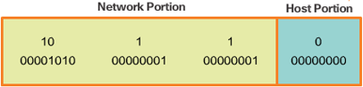
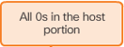
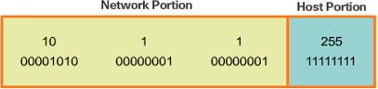
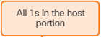
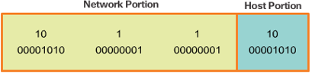
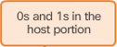
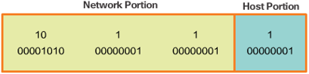
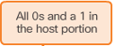
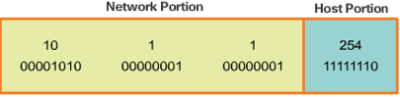
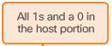
Network, Broadcast, and Host Addresses
Play slideshow to see animations
Network address:
Broadcast address:
Host address:
1st host address:
Last host address:

Slide 13
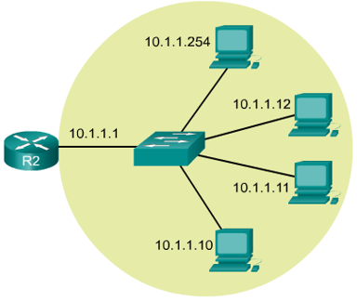
Network address
The network address and the subnet mask together uniquely identify the whole network (i.e. the whole range of addresses in the network). How or why?
Examples:
Assume the network address of the network on the right is 10.1.1.0/24
“/24” tells us that the network portion of any address in the network occupies 24 bits and they must be the same for all addresses in the network, which is 10.1.1.
“/24” also indicates that the host portion occupies the remaining 8 bits, hence the host portions of an address in the network can take values from 00000000 to 11111111 (0 to 255), giving us the address range (the whole network), which is 10.1.1.0 to 10.1.1.255 (note that the usable host address range is from 10.1.1.1 to 10.1.1.254)
Now let’s say the network address is changed to 10.1.0.0/16. Note that only the subnet mask is changed, to /16.
Let’s see what is the range of addresses of the network.
“/16” says that the network portion of any address in the network occupies the first 16 bits, and they must be the same, i.e. 10.1.
“/16” also indicates that the host portion of an address occupies the remaining 16 bits, taking values from 00000000.00000000 to 11111111.11111111 (0.0 to 255.255)
So this network contains addresses ranging from 10.1.0.0 to 10.1.255.255 – a much bigger range than the previous network

Slide 14
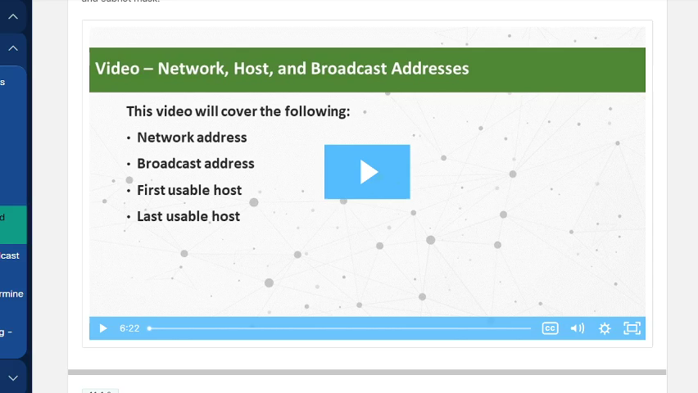
Identify network, host and broadcast addresses
Watch the video to see, when given an IP address together with its subnet mask, how to use bit-wise ANDing to find out the address information about the network to which this IP address belongs, including the network address, 1st and last usable host addresses and broadcast address of the network.

Slide 15
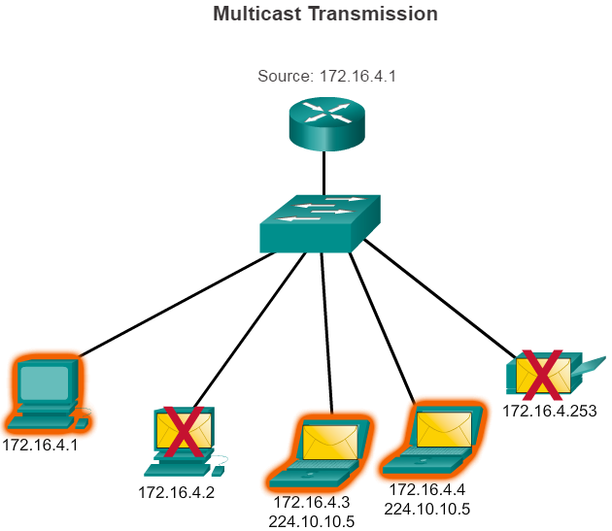
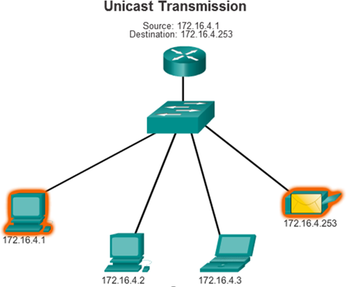
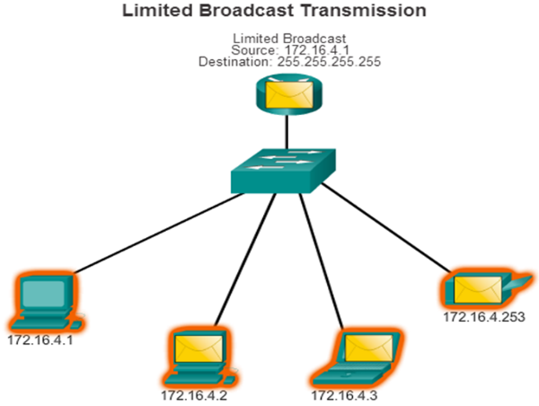
IPv4 transmission methods
Method | Purpose | Source address in the IP packet to be sent | Destination address in the IP packet to be sent
Unicast | host-to-host | Sender’s IPv4 address | Receiver’s IPv4 address
Broadcast | host-to-all | Sender’s IPv4 address | Broadcast address*
Multicast | host-to-many | Sender’s IPv4 address | A multicast address**
When a packet is broadcast to the sender’s local network (called limited or local broadcast, the destination IP address of the packet is 255.255.255.255; When a broadcast packet is sent to all hosts on a specific network (called directed broadcast), the destination IP address of the packet is the broadcast address of that specific network, but routers by default do not forward broadcast packets to remote networks.
** Each multicast group is represented by a single IPv4 multicast address which is in the range of 224.0.0.0 to 239.255.255.255.
When a packet is sent to a multicast group, the destination IP address of the multicast packet is in this multicast address
range. Within this range, addresses 224.0.0.0 to 224.0.0.255 are reserved for multicasting on the local network only.

Slide 16
Types of IPv4 addresses
The IPv4 address space contains IP addresses ranging from 0.0.0.0 to 255.255.255.255, which has been divided into different blocks or types of addresses for different purposes:
Public addresses: addresses which are globally routed between ISP (Internet Service Provider) routers. Ranges vary.
Private addresses: addresses in the ranges of
10.0.0.0 to10.255.255.255 (i.e. 10.0.0.0/8);
172.16.0.0 to 172.31.255.255 (i.e. 172.16.0.0 /12)
192.168.0.0 to 192.168.255.255 (i.e. 192.168.0.0 /16)
Private IP addresses are not routed by ISP routers, i.e. when an IP packet with a private IP address as its destination address reaches a router, the packet will be discarded.
Special use addresses:
Loopback addresses: in the range of 127.0.0.1 to 127.255.255.254. Used by a host to direct traffic to itself. Address 127.0.0.1 is used commonly.
Automatic Private IP Addressing (APIPA) addresses: in the range of 169.254.0.1 to 169.254.255.254, Used by a Windows DHCP client to self-configure in the event that there are no DHCP servers available.
TEST-NET addresses: in the range of 192.0.2.0 to 192.0.2.255. Addresses that are set aside for teaching and learning purposes and can be used in documentation and network examples.

Slide 17
More on private IPv4 Addresses
In the mid-1990s private IPv4 addresses were introduced because of the depletion of IPv4 address space.
Most organizations use private IPv4 addresses for their internal hosts nowadays.
Private IPv4 addresses are not unique and can be used by any network as internal addresses.
However, these address are not routable in the Internet and must be translated to a public IPv4 address using Network Address Translation (NAT), done on the router that connects the internal network to the ISP's network.
Home routers provide the same capability.
For instance, most home routers assign IPv4 addresses to their wired and wireless hosts from the private address of 192.168.1.0 /24.
The home router interface that connects to the ISP’s network is assigned a public IPv4 address to use on the Internet.

Slide 18
Assignment of IP addresses
Allocation of blocks of public IP addresses is done in a hierarchical way:
Internet Assigned Numbers Authority (IANA) manages and allocates blocks of IP addresses to the Regional Internet Registries (RIRs).
RIRs are responsible for allocating IP addresses to ISPs who in turn provide IPv4 address blocks to organizations and smaller ISPs.
Organizations can get their addresses directly from an RIR subject to the policies of that RIR.
In an organisation, host addresses are assigned using one of the two methods:
Static assignment
Devices such as printers and servers require a fixed IP address. These devices are typically assigned static IP addresses.
Dynamic assignment
In most networks, the largest population of hosts includes PCs, tablets, smartphones, printers, and IP phones are assigned IPv4 addresses dynamically using the Dynamic Host Configuration Protocol (DHCP).
The host is a DHCP client and requests IP address information from a DHCP server, and the DHCP server provides an IP address, subnet mask, default gateway, and other configuration information.

Slide 19
Classful vs. classless addressing
Initially in the early 1980s, the classful addressing was used. Customers were allocated a network address (a range of IP addresses) of one the three classes, A, B, or C:
In the late 1980s, classful addressing was abandoned, as not all organizations' requirements fit well into one of these three classes. A great deal of addresses were wasted. For example, 50% of the available IPv4 addresses were for the 128 Class A networks, but a class A network can be too big for an organisation normally.
Today we use classless addressing, which ignores the rules of classes, and a set of standards have been developed to allow service providers to allocate IPv4 addresses on any address bit boundary (prefix length), but there are still classful remnants in networks today.
Network class | Address block | Subnet mask | Max. number of networks | # hosts per network
A | 0.0.0.0/8 to 127.0.0.0/8 | /8 | 128 | 2^24-2 = 16,777,214
B | 128.0.0.0 /16 - 191.255.0.0 /16 | /16 | 16,384 | 2^16-2=65,534
C | 192.0.0.0 /24 - 223.255.255.0 /24 | /24 | 2,097,152 | 2^8-2=254

